Slide 1
Fraud detection under noise
01
Our VQC ignores the noise.
It ranks fraud above logistic regression.
Noise-Covariant Re-uploading Classifier · 5 seeds · 56,962 test payments, 98 frauds
Notes:
Speaking time: 0:00 to 0:15. SAY: We built a quantum fraud detector whose ranking of payments does not change at all under the challenge’s gate noise. Its AUPRC is 0.735 at every noise level, above the original VQC (0.405 at p = 0.05) and above logistic regression (0.703). Logistic regression still has the slightly better F1 at a single threshold, and we say so later. Source: src/run.py results in results/raw, five seeds.

Slide 2
How we changed the circuit
02
Original VQC
Entangled NCRC
NCRC (ours)
93
25
16
gates
gates
gates
Reuse the notebook circuit.
Feed the 4 inputs in at every layer.
Remove every CNOT: 4 independent qubits.
33 CNOTs tie the qubits together.
16 rotations plus 9 CNOTs.
Read the first qubit for the fraud score.
Our circuit with entanglement put back.
Exactly 4 rotations on each qubit.
Score = average of the 4 qubits.
A gate is one circuit operation, and noise strikes after every one. With no CNOTs, noise only shrinks every score by the same factor, so the order of payments cannot change.
Same 4 inputs and training data · 5 seeds · 56,962 test payments, including 98 frauds
Notes:
Speaking time: 0:15 to 0:55. SAY: We compare three quantum circuits. First, the notebook circuit: 93 gates, 33 of them CNOTs, read from the first qubit. Third, ours: 16 gates, no CNOTs, four separate qubits with exactly four rotation gates each, and the inputs fed in again at every layer so the circuit stays expressive without entanglement. The middle one is ours with a CNOT chain put back: the cleanest test of whether entanglement is what lets noise scramble the ranking. Every model sees the same four inputs and the same 590 balanced training rows; five seeds; the full test set. Source: src/models.py, results/raw.

Slide 3
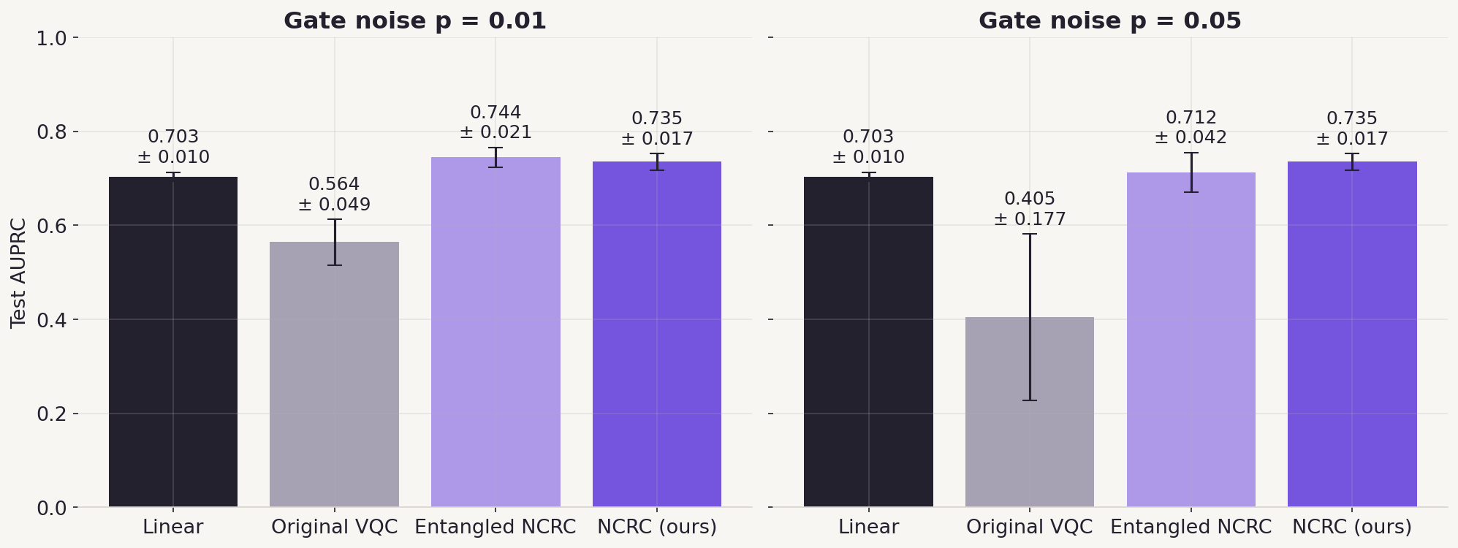
Fraud ranking did not move under noise
03
At p = 0.05: ours 0.735 ± 0.017, the original VQC 0.405 ± 0.177. Ours is identical at every noise level.
AUPRC: higher is better · mean ± standard deviation across 5 training seeds · full test set
Notes:
Speaking time: 0:55 to 1:45. SAY: AUPRC tells us how well frauds rank above legitimate payments across all alert thresholds; higher is better. Under stronger noise the original VQC falls to 0.405 and its spread across seeds grows to 0.177. The entangled version slips to 0.712. Ours stays at 0.735 at both noise levels, exactly, with a spread of 0.017, and above logistic regression’s 0.703, which has no gates so noise cannot touch it. Source: results/raw, five seeds.

Slide 4
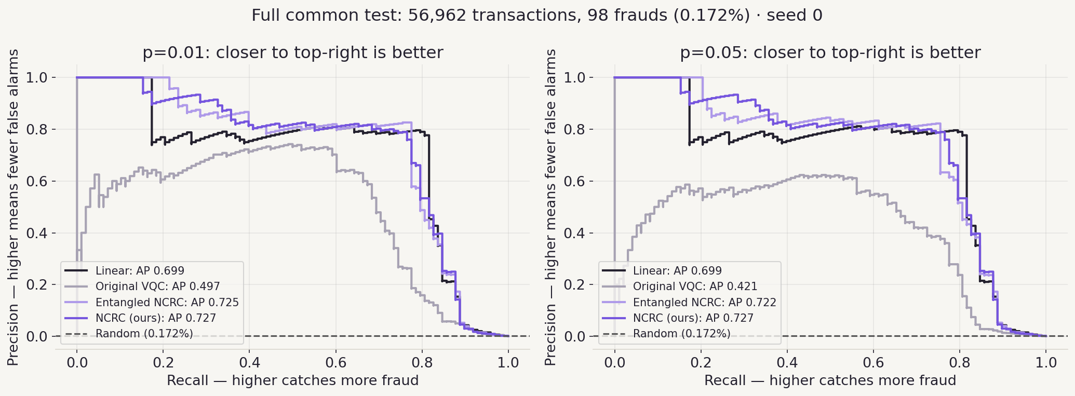
Precision and recall
04
Recall = share of frauds caught. Precision = share of alerts that are real fraud. At the same recall, higher precision means fewer false alarms; AUPRC summarises the curve.
Seed 0 · full test set · moving the alert threshold draws the curve
Notes:
Speaking time: 1:45 to 2:20. SAY: Recall is the share of frauds we catch; precision is the share of alerts that are really fraud, so precision 0.8 means eight real frauds in ten alerts. Moving the alert threshold draws the curve, and AUPRC summarises it. In this seed ours keeps exactly the same curve at both noise levels, average precision 0.727, while the original VQC’s curve sinks from 0.497 to 0.421. We plot one fixed seed; headline numbers average five. Source: src/demo_seed0.py, results/demo/seed0.npz.

Slide 5
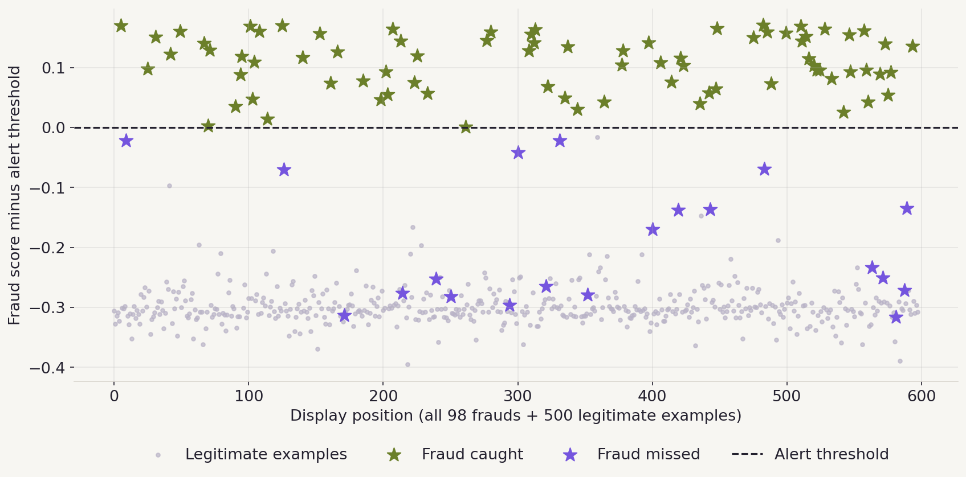
78 frauds caught, at any noise level
05
Green stars are above the alert threshold and caught; purple stars are missed. Seed 0: 78 of 98 caught, 20 missed, the same at p = 0 and p = 0.05. Linear catches 80.
All 98 frauds + 500 legitimate payments shown for readability · metrics use all 56,962 · threshold chosen on validation
Notes:
Speaking time: 2:20 to 2:55. SAY: Each star is a real test fraud. Green stars are above the alert threshold and caught; purple stars are below it and missed; grey dots are legitimate payments. In seed 0 our model catches 78 of 98 frauds at every noise level, because the threshold, chosen on validation data, moves with the uniform shrink. The honest comparison: linear catches 80 with 28 false alarms; ours 78 with 42 in this seed; averaged over five seeds ours flags 27. Source: results/demo/seed0.npz.

Slide 6
What actually helped
06
Remove every CNOT
Packed gradients
Noise stops reordering payments: AUPRC at p = 0.05; the spread more than halves.
Shift one angle on all 4 independent qubits at once. Identical results on every seed.
0.712 → 0.735
81 → 15 runs
Cheaper training
Optional ranking loss
15 epochs, check progress on 20% of validation. Small AUPRC cost.
Reward frauds scored above legitimate payments. AUPRC up on 3 of 5 seeds.
0.735 → 0.721
F1 0.763 → 0.796
All on the full test set, 5 seeds · runs = circuit runs per training payment
Notes:
Speaking time: 2:55 to 3:45. SAY: We tested each change separately. Removing the CNOTs is the core: the same circuit with CNOTs drops to 0.712 at strong noise and varies twice as much; without them it holds 0.735. Because the four qubits never interact, one circuit run can shift the same angle on all four and still read each qubit’s own gradient: 15 runs per training payment instead of 81, with mathematically identical results; we re-trained all five seeds to check. Cheap training, 15 epochs and checking progress on 20% of validation, costs 0.014 AUPRC. An optional ranking term in the loss lifts F1 to 0.796 on every seed, but AUPRC only on three of five, so we keep the plain version as the headline. Source: results/raw, RESULTS.md.

Slide 7
Quantum budget: robust and cheaper
07
Linear
0 — no quantum calls
Original VQC
2.43 M
−88%
NCRC, standard gradients
3.14 M
circuit runs vs the original VQC, at AUPRC 0.721
NCRC, packed gradients
1.97 M (−19%)
NCRC, packed + cheap training
0.30 M (−88%)
Linear needs no quantum calls. Same 30-epoch schedule: our circuit costs 19% less than the original once gradients are packed.
Training + validation circuit runs per seed · 1,024 measurements per run · measured on all 5 seeds
Notes:
Speaking time: 3:45 to 4:20. SAY: The budget counts how many times a quantum device would have to run the circuit to train the model, with 1,024 measurements per run. The original VQC needs 2.43 million. Ours with standard gradients needs more, 3.14 million, because it has more angles to train. But its qubits never interact, so packed gradients bring it to 1.97 million on the same schedule, 19% less, with identical results. Train cheaper and it is 0.30 million, 88% less, still at AUPRC 0.721. No error mitigation, so no hidden extra runs. Source: ledger field in results/raw.

Slide 8
Where our VQC beats the linear model, and where it doesn’t
08
How the linear score is made
Learn 4 weights and 1 offset. Multiply the 4 inputs by the weights, add up, convert to a score.
AUPRC with noise switched off
0.703
0.580
0.735
How our score is made
Turn each of 4 qubits by angles that depend on the inputs, 4 times, then average the 4 readings.
Linear
Original VQC
NCRC (ours)
Ours ranks frauds better. At one alert threshold linear keeps a higher F1, 0.791 vs 0.763, unless we add the ranking loss (0.796).
Full test set, 5 seeds · linear = LogisticRegression on the same 4 inputs
Notes:
Speaking time: 4:20 to 5:00. SAY: The linear model learns one weight per input plus an offset. Our circuit turns each qubit by angles computed from the inputs, four times, and averages the four readings, which gives it curved decision boundaries. With noise off, linear scores 0.703, the original VQC 0.580 and ours 0.735, and ours keeps 0.735 under noise. Honestly: at a single alert threshold the linear model still has the higher F1, 0.791 against 0.763; the optional ranking loss closes that gap. And linear needs no quantum hardware at all, so we claim robustness and cost, not quantum advantage. Source: results/raw.

Slide 9
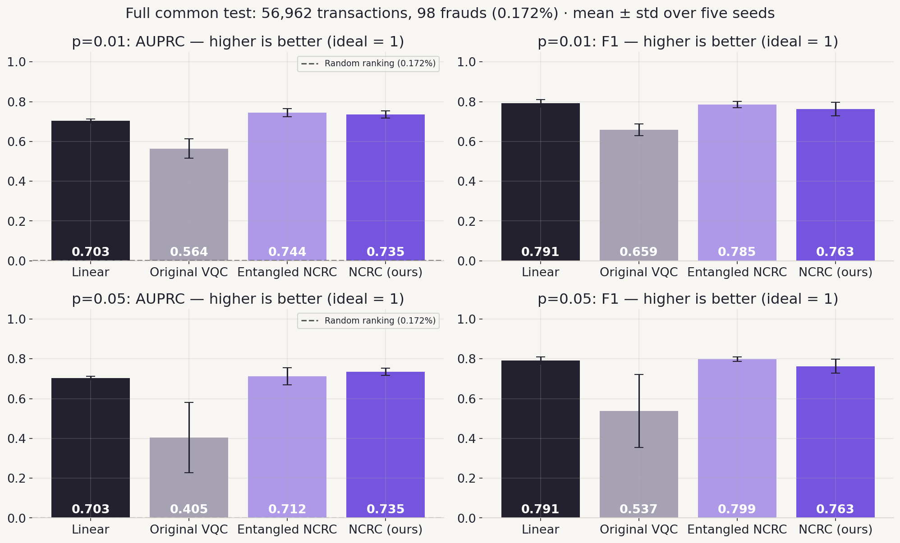
AUPRC and F1 at both noise levels
09
Ours leads on AUPRC at p = 0.05 (0.735); linear and the entangled version keep a slightly higher F1.
Full test set · mean ± std over 5 seeds · higher is better
Notes:
APPENDIX FOR REHEARSAL AND QUESTIONS. READ: AUPRC measures fraud ranking across all alert thresholds; F1 measures the balance between catching fraud and avoiding false alerts at the chosen threshold. FINDING: at p = 0.05, AUPRC is 0.703 linear, 0.405 original, 0.712 entangled, 0.735 ours; F1 is 0.791, 0.537, 0.799, 0.763. WHY: ranking is exactly noise-proof for our circuit; the single threshold is chosen on validation and transfers slightly less well. LIMIT: five seeds describe variation, not significance.

Slide 10
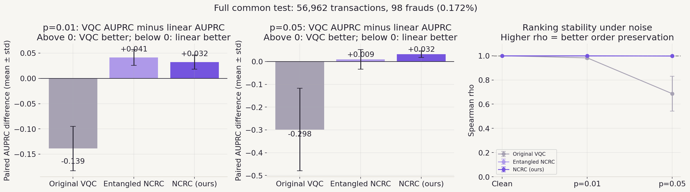
The gap to linear, and ranking stability
10
Ours is ahead of linear by +0.032 AUPRC at both noise levels, and its ranking never changes (ρ = 1).
Paired by seed · full test set · Spearman ρ between noisy and noiseless scores
Notes:
APPENDIX FOR REHEARSAL AND QUESTIONS. READ: the bars subtract the linear model’s AUPRC from each VQC on the same seed; above zero means the VQC is better. The right panel asks whether noise changes the order of payments compared with the circuit’s own clean scores. FINDING: at p = 0.05 ours is +0.032, the entangled version +0.009, the original −0.298; ρ is 1.000 for ours, 0.997 entangled, 0.686 original. WHY: without CNOTs every channel shrinks every score by the same factor (1 − 4p/3)^4.

Slide 11
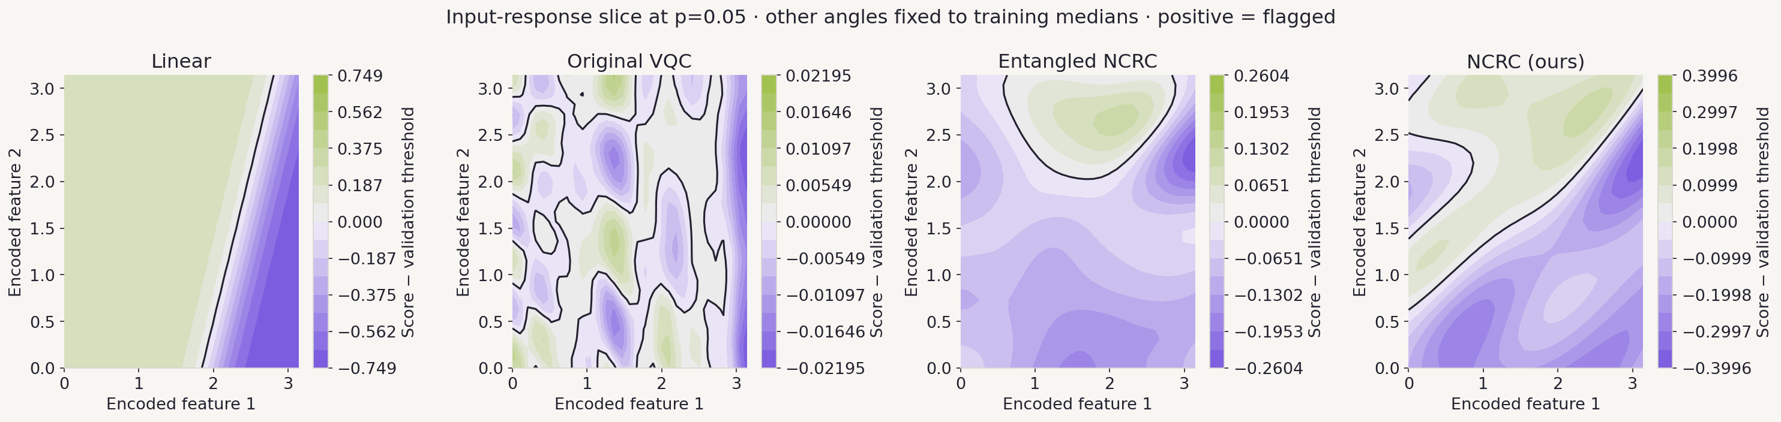
Simple and curved decision boundaries
11
The linear model draws one straight line. Ours draws smooth curved boundaries, and keeps a wide score range under noise; the original VQC’s map breaks into islands.
Seed 0 · synthetic input combinations for illustration, not test payments · each panel has its own colour scale
Notes:
APPENDIX FOR REHEARSAL AND QUESTIONS. READ: we vary two of the four inputs and hold the other two at their training medians; green is flagged, purple is not. FINDING: linear is a straight boundary; the original VQC’s noisy scores span only ±0.02 and break into islands; ours spans ±0.40 with smooth curves. WHY: re-uploading the inputs at every layer gives curved boundaries without entanglement; noise shrinks ours uniformly instead of scrambling it. LIMIT: illustration only; curvier is not automatically better.

Slide 12
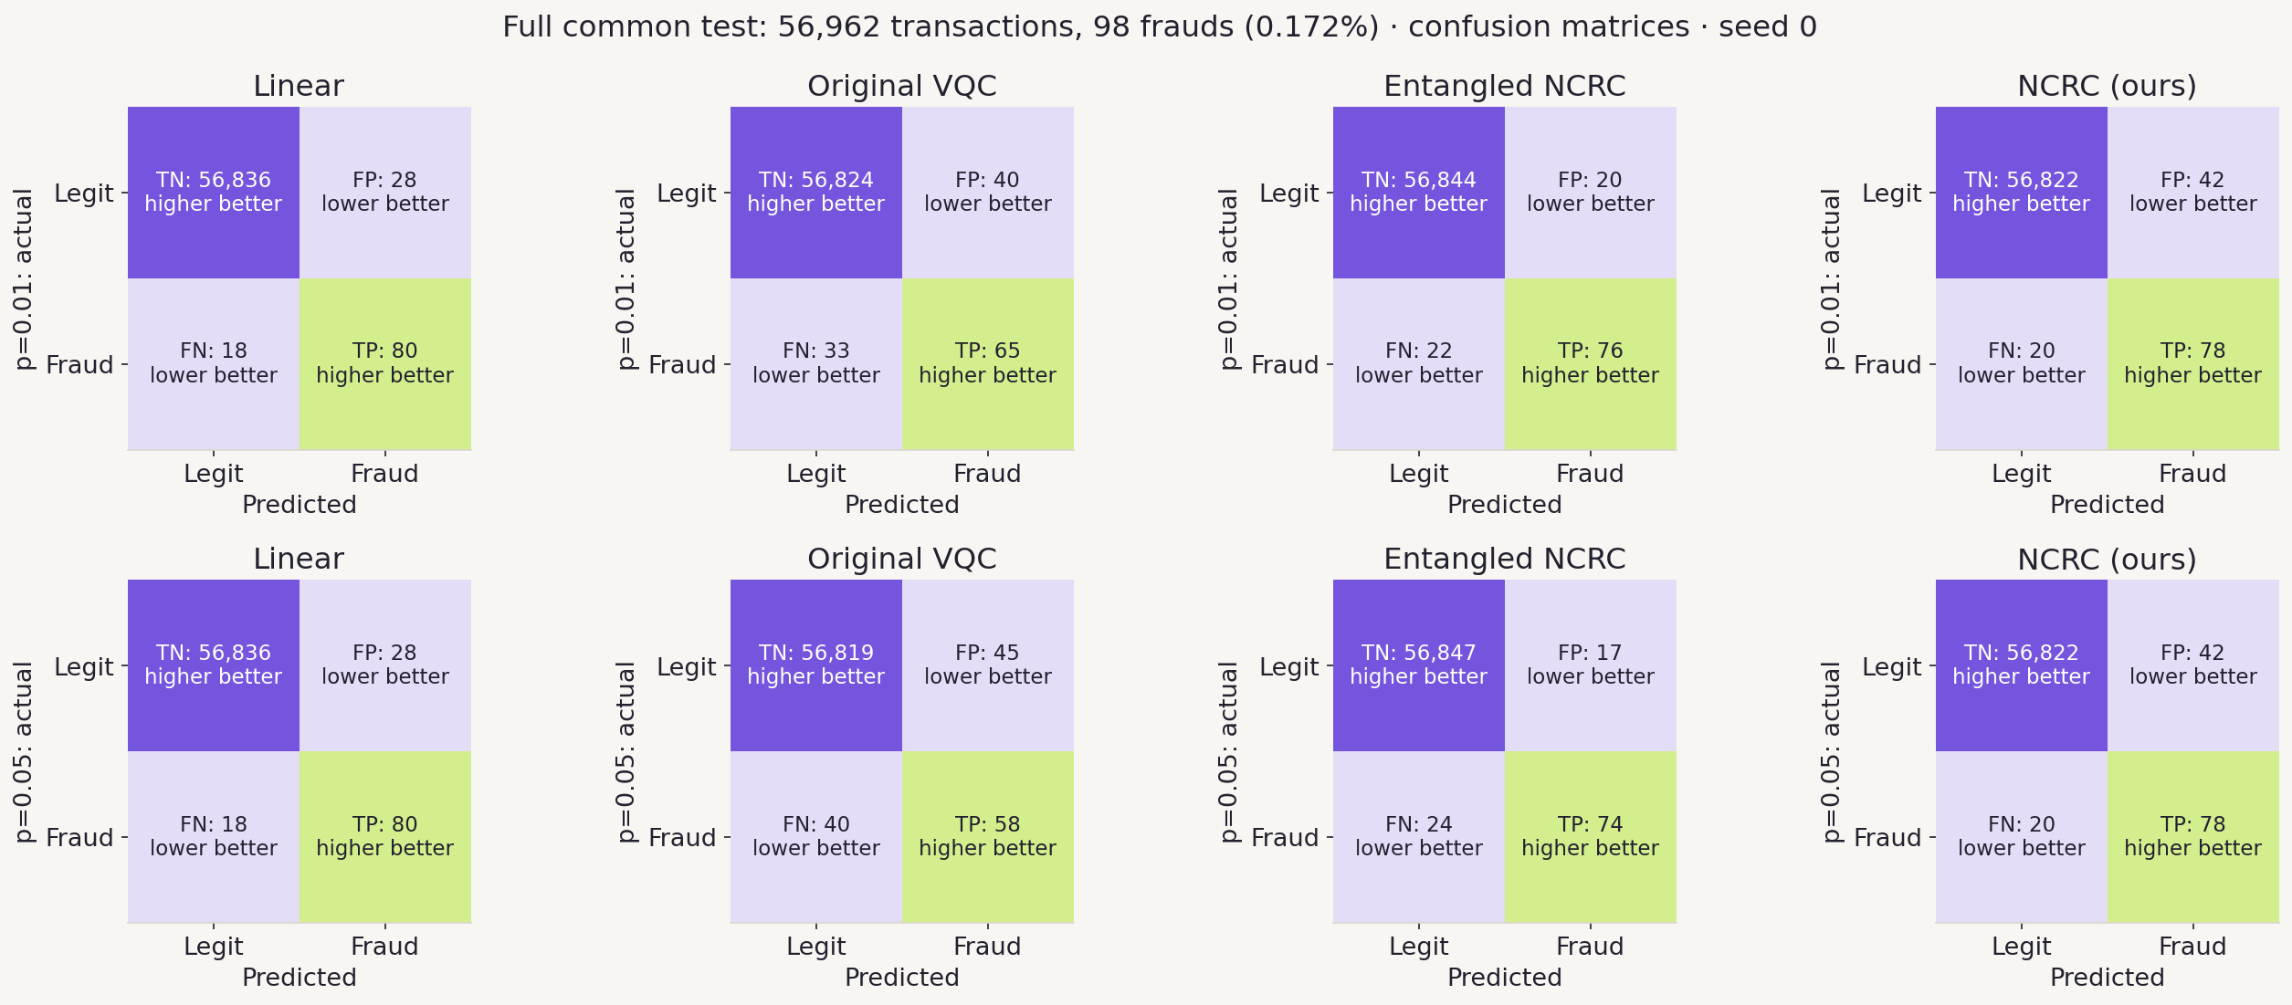
Actual decisions at both noise levels
12
Caught frauds and correct rejections should be high; missed frauds and false alarms low. Ours gives the same decisions at both noise levels.
Seed 0 · all 56,962 test payments · threshold from validation at the same noise level
Notes:
APPENDIX FOR REHEARSAL AND QUESTIONS. READ: each matrix counts every payment in the 56,962-row test set for seed 0. FINDING: at p = 0.05, linear catches 80 with 28 false alarms; the original 58 with 45; entangled 74 with 17; ours 78 with 42, identical at p = 0.01. Over five seeds ours averages 77 caught and 27 false alarms. WHY: the threshold is chosen on validation at the same noise level; for ours the order never changes, so the decisions never change. LIMIT: one seed; false-alarm counts vary by seed.

Slide 13
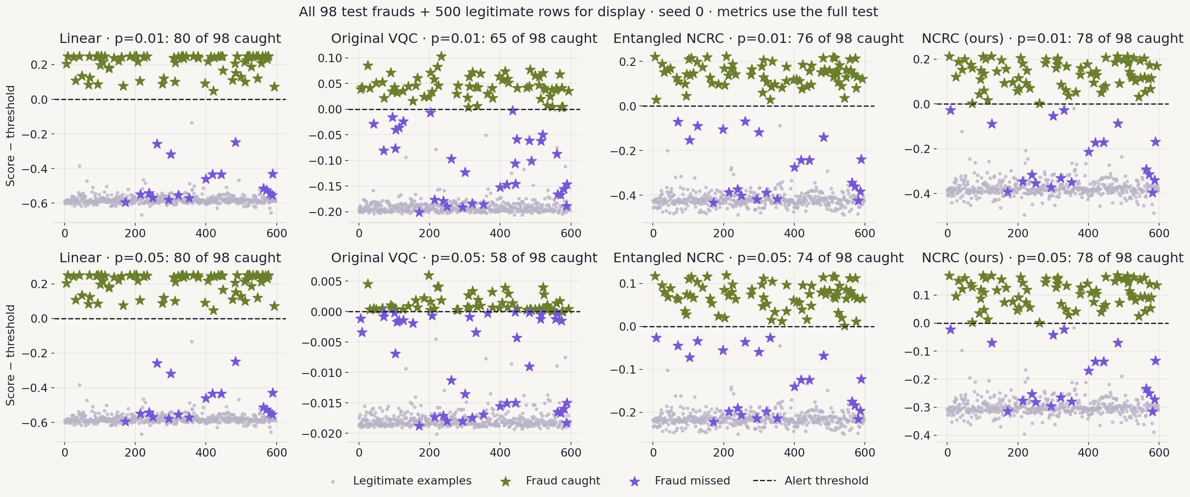
All frauds relative to the alert threshold
13
Green stars were caught; purple stars were missed. Every test fraud is shown, for every model and both noise levels.
Seed 0 · all 98 frauds + 500 legitimate payments for display · metrics use the full test set
Notes:
APPENDIX FOR REHEARSAL AND QUESTIONS. READ: the dashed line is the alert threshold; zero is the boundary for every model because each axis subtracts that model’s own threshold. FINDING: at p = 0.05 linear catches 80, the original 58, entangled 74, ours 78. The original’s points crowd close to the line under noise, which is why shot noise later overwhelms it. LIMIT: a display sample of legitimate payments; one seed.

Slide 14
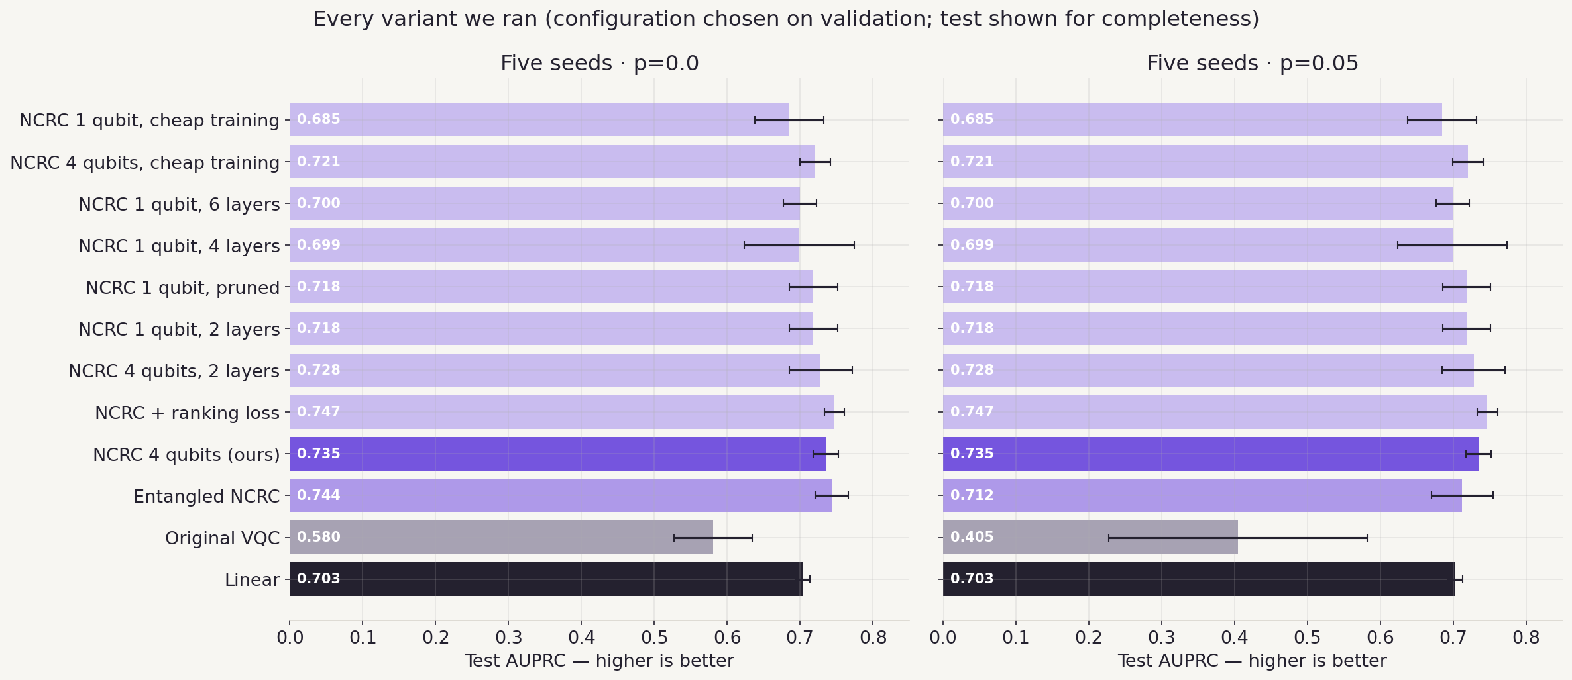
Every variant we ran
14
More layers did not help; four qubits beat one; entanglement helps without noise but loses under it.
Five seeds · configuration chosen on validation (0.724) · test shown for completeness
Notes:
APPENDIX FOR REHEARSAL AND QUESTIONS. READ: every configuration we trained, five seeds each, test AUPRC without noise and at p = 0.05. FINDING: 1 qubit 2 layers 0.718, 4 layers 0.699, 6 layers 0.700; 4 qubits 2 layers 0.728, 4 layers 0.735; entangled 0.744 clean but 0.712 at p = 0.05; cheap training 0.721; ranking loss 0.747. WHY: depth made training less stable; entanglement trades noise robustness for a little clean accuracy. LIMIT: the headline was picked on validation before looking at these test numbers.

Slide 15
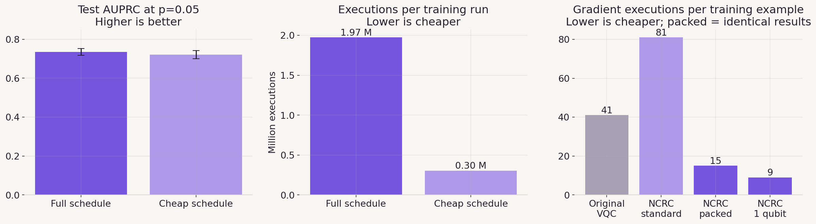
Cheaper training and packed gradients
15
Packed gradients give identical results for 15 runs per payment; cheap training costs 0.014 AUPRC.
Packed results checked against standard gradients to 10⁻¹⁶ and re-trained on all 5 seeds
Notes:
APPENDIX FOR REHEARSAL AND QUESTIONS. READ: left, AUPRC for the full 30-epoch schedule and the cheap one (15 epochs, progress checked on 20% of validation); middle, the runs each needs; right, runs per training example for each gradient method. FINDING: 0.735 vs 0.721 AUPRC; 1.97 M vs 0.30 M runs; 81 runs with standard gradients, 15 packed. WHY: neighbouring Z rotations merge into one angle, and the same angle is shifted on all four independent qubits in one run.

Slide 16
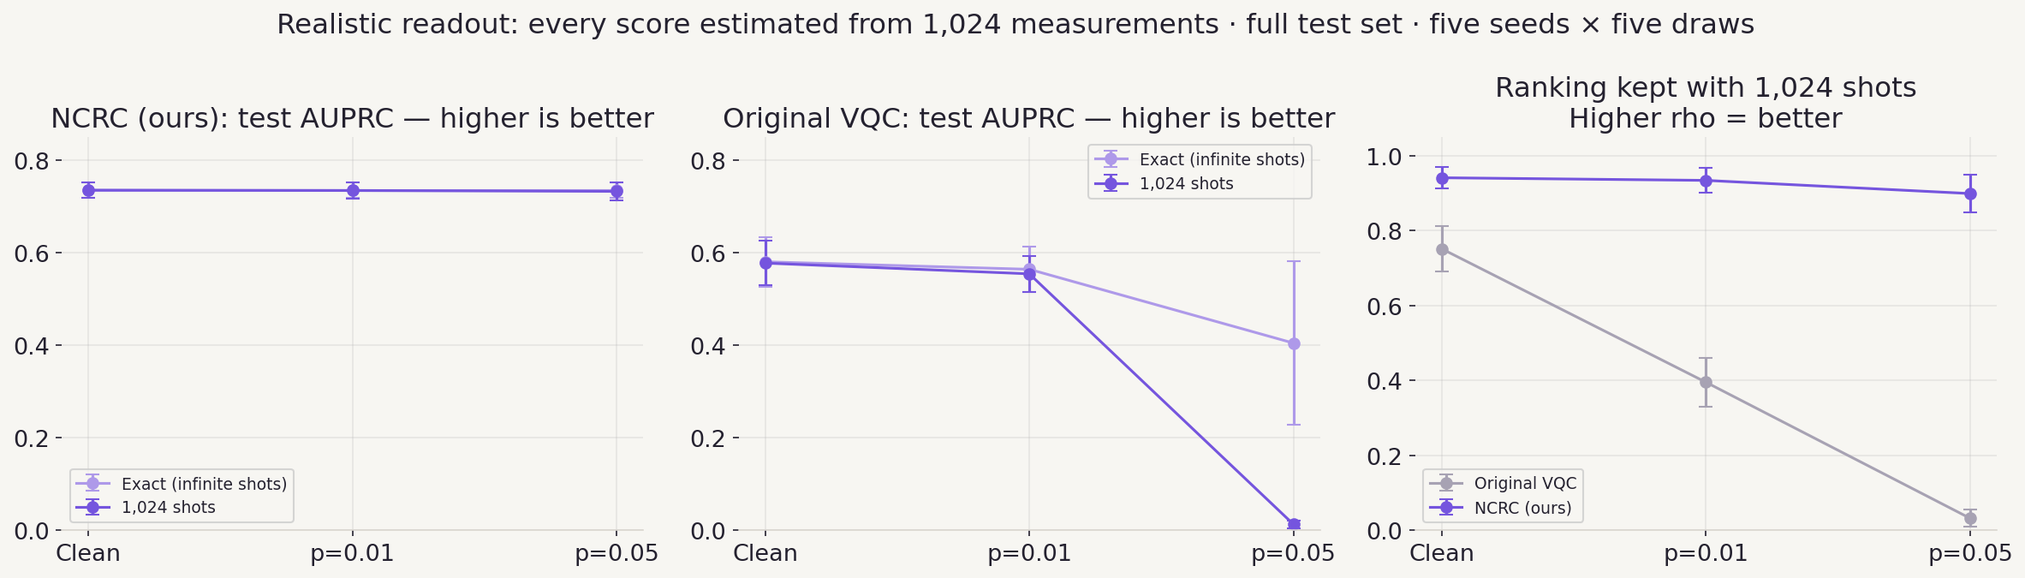
A real readout: 1,024 measurements per score
16
With shots, ours loses 0.002 AUPRC; the original VQC collapses to 0.013, no better than random.
Full test set · 5 seeds × 5 independent shot draws · our 4 qubits measured separately
Notes:
APPENDIX FOR REHEARSAL AND QUESTIONS. READ: exact simulation is the infinite-shot limit; a device estimates each score from measurements. FINDING: at p = 0.05 ours 0.735 exact, 0.733 with 1,024 shots; the original 0.405 exact, 0.013 with shots; the entangled version 0.712 exact, 0.708 with shots (sampled as whole 4-qubit bitstrings). WHY: noise squeezes the original’s scores into a band narrower than the shot wobble; ours shrinks only by (1 − 4p/3)^4 = 0.76 and averages four independent qubits. This replaces the ZNE slide: we use no error mitigation.

Slide 17
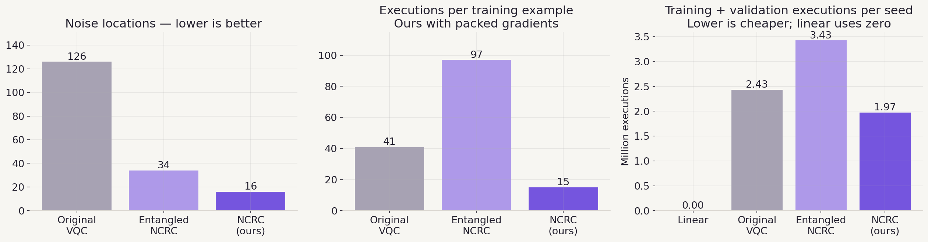
Circuit counts and cost
17
Fewer noise locations and packed gradients: ours needs 1.97 M runs per seed against 2.43 M.
Measured ledgers from results/raw · 1,024 shots per run
Notes:
APPENDIX FOR REHEARSAL AND QUESTIONS. READ: noise locations count where a noise channel is inserted; executions per example is the gradient cost; the right panel is the full training plus validation budget per seed. FINDING: 126 → 34 → 16 noise locations; 41, 97 and 15 runs per example; 2.43 M, 3.43 M and 1.97 M runs per seed. WHY: validation passes cost 1.71 M for every model on the full schedule, so cheaper checking is the next big saving (0.30 M with cheap training).

Slide 18
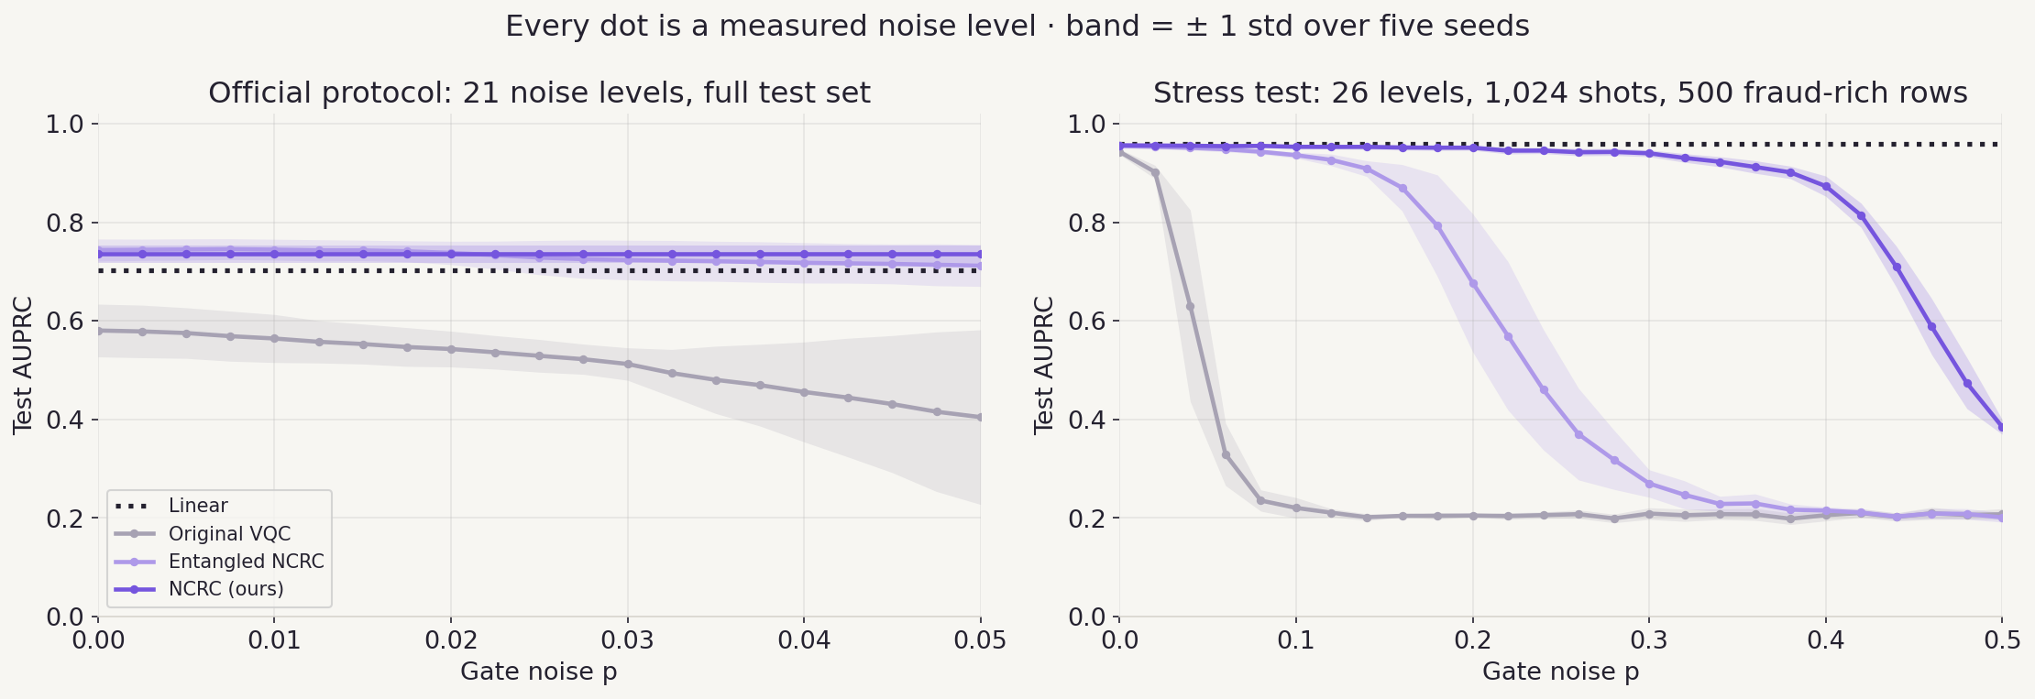
Every value in between: dense noise sweeps
18
Every dot is a measured level. Under heavy noise everyone bends, ours last.
Left: official protocol, exact · right: stress test, 20% fraud set (random = 0.20)
Notes:
APPENDIX FOR REHEARSAL AND QUESTIONS. READ: instead of four noise levels joined by straight lines, each curve is measured point by point. FINDING: official protocol, ours 0.735 at all 21 levels; original 0.580 → 0.405. Stress test: original near random by p = 0.08, entangled breaks around 0.25 (0.677 at p = 0.2, 0.270 at 0.3), ours 0.940 at p = 0.3, 0.873 at 0.4, 0.385 at 0.5; linear 0.959 throughout. HOW: our qubits are sampled separately, the entangled model’s as whole 4-qubit bitstrings because its qubits are correlated. LIMIT: the stress set is 20% fraud, so its AUPRC is not comparable with the headline.

Slide 19
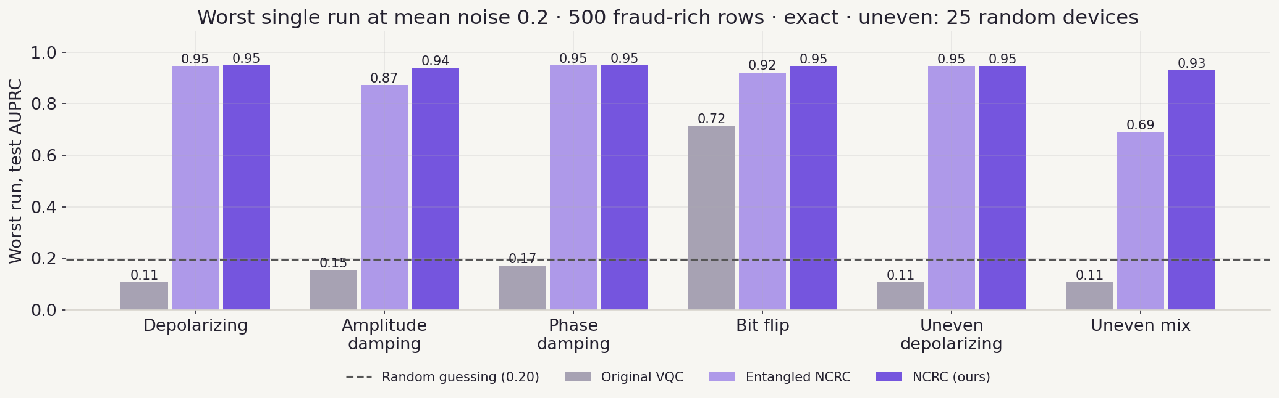
Not just on average: the worst run of every noise
19
Our worst run anywhere is 0.93. The original’s worst runs fall below random guessing.
Exact simulation · 500 fraud-rich rows · uneven noise: every gate its own random strength (and type), 25 runs
Notes:
APPENDIX FOR REHEARSAL AND QUESTIONS. READ: each bar is the single worst run, not the average. Uneven noise gives every gate its own random strength, and in the mix its own noise type too. FINDING: ours 0.93 to 0.95 everywhere; original 0.11 under depolarizing and uneven noise, below random 0.20, meaning its ranking flips; entangled 0.69 in the uneven mix. WHY: only uniform depolarizing noise is covered exactly by the guarantee; elsewhere few gates per qubit keep it close. We re-checked these with an independent NumPy simulation.

Slide 20
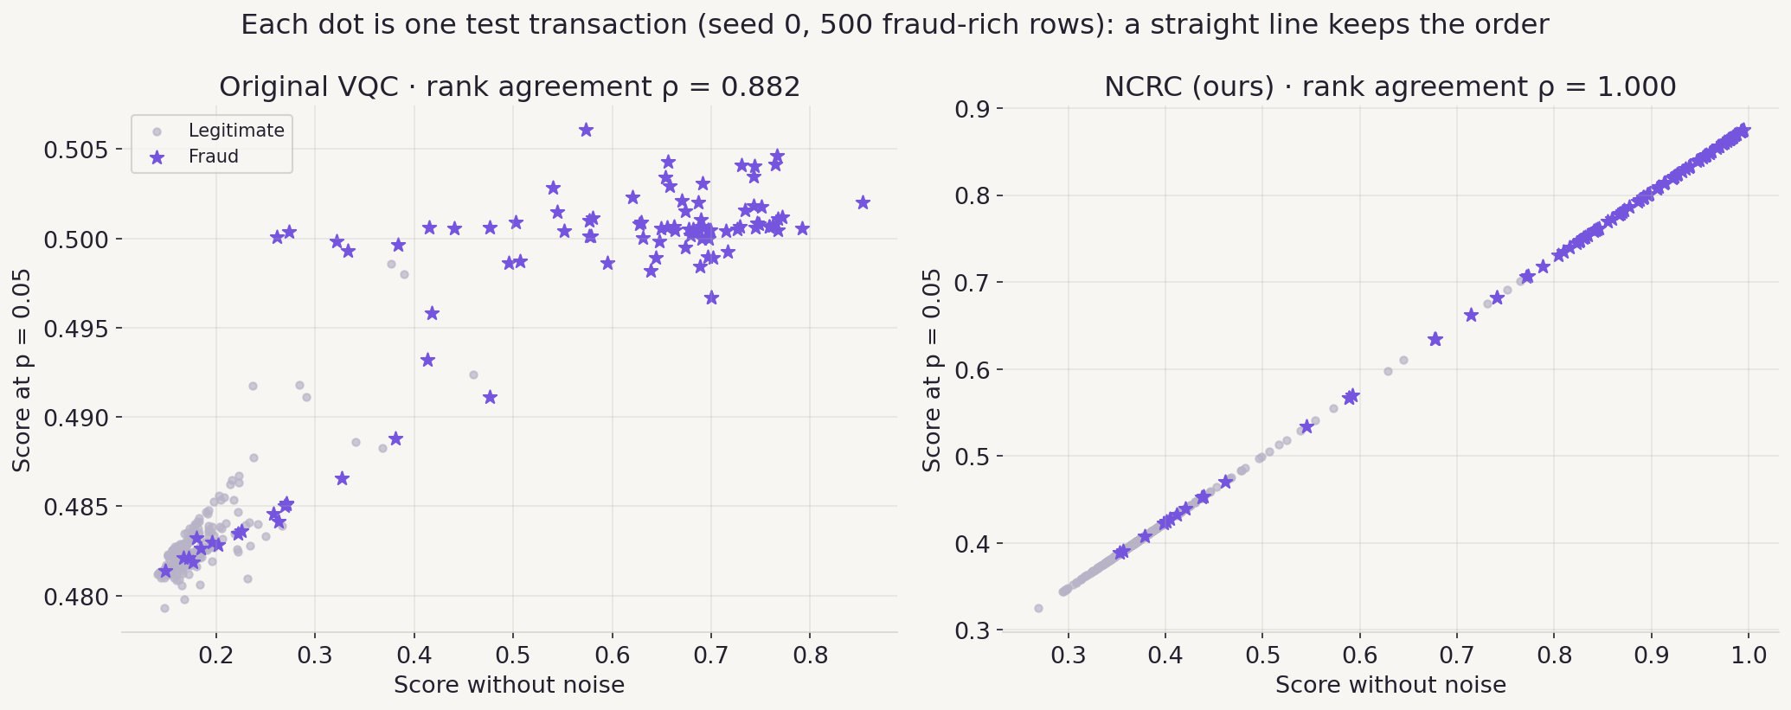
Every payment, before and after noise
20
On a straight line the order is kept, so the same frauds stay on top.
Seed 0 · 500 fraud-rich test rows · exact simulation
Notes:
APPENDIX FOR REHEARSAL AND QUESTIONS. READ: horizontal axis, the score without noise; vertical axis, the score of the same payment at p = 0.05. FINDING: the original VQC’s points scatter (rank agreement 0.882) and its scores squeeze into 0.48 to 0.51; ours lie on one straight line (1.000). WHY: every payment’s score is shrunk by the same factor, so the order, which is all AUPRC uses, cannot change.

